Slide 1
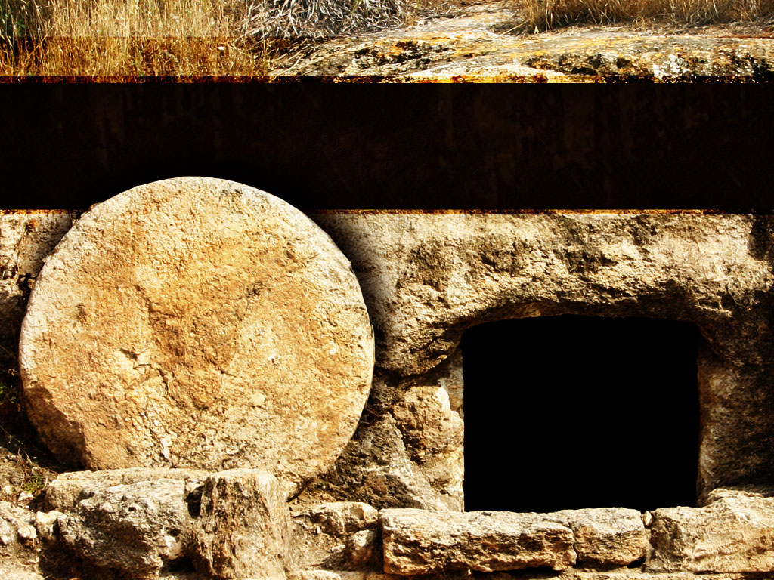
What Does Easter Prove? Ephesians 1:19-20a
March 31, 2024
Pastor Rolly

Slide 2
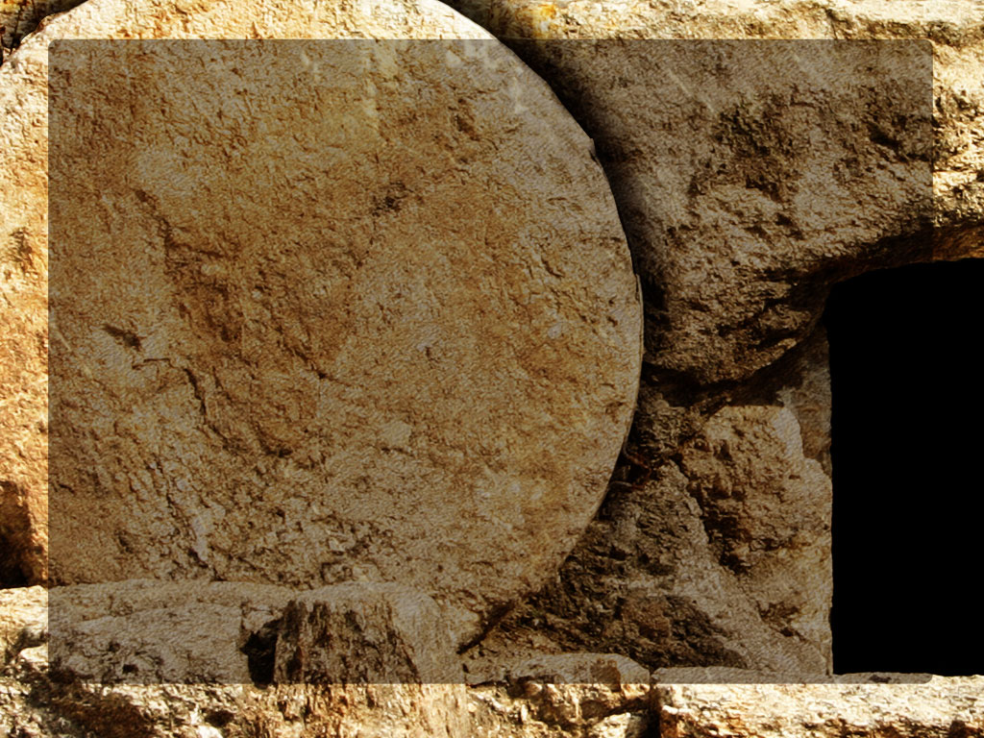
Ephesians 1:19-20a (NLT)
“I also pray that you will understand the incredible greatness of God’s power for us who believe him. This is the same mighty power that raised Christ from the dead.”

Slide 3
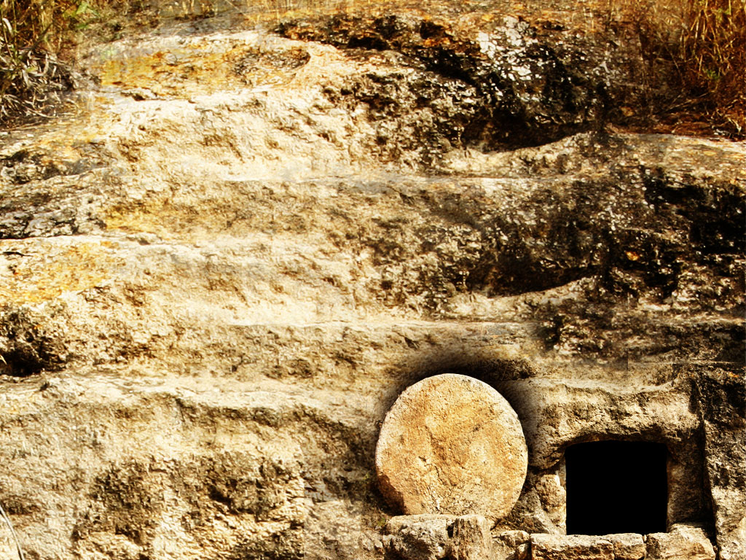
1. God is in control.

Slide 4
Ephesians 1:19-20a (NLT)
“I also pray that you will understand the incredible greatness of God’s power for us who believe him. This is the same mighty power that raised Christ from the dead.”

Slide 5
Proverbs 19:21 (NIV)
“Many are the plans in a man’s heart, but it is the Lord’s purpose that prevails.”

Slide 6
Isaiah 41:10 (NIV)
“So do not fear, for I am with you; do not be dismayed, for I am your God. I will strengthen you and help you; I will uphold you with my righteous right hand..”

Slide 7
1. God is in control. 2. God keeps his promises. Always.

Slide 8
Ephesians 1:19-20a (NLT)
“I also pray that you will understand the incredible greatness of God’s power for us who believe him. This is the same mighty power that raised Christ from the dead.”

Slide 9
Numbers 23:19 (NIV)
“God is not man, that he should lie, not a son of man, that he should change his mind. Does he speak and then not act? Does he promise and not fulfill?”

Slide 10
1. God is in control. 2. God keeps his promises. Always. 3. God can do the impossible.

Slide 11
Ephesians 1:19-20a (NLT)
“I also pray that you will understand the incredible greatness of God’s power for us who believe him. This is the same mighty power that raised Christ from the dead.”

Slide 12
Luke 1:37 (ESV)
“For nothing will be impossible with God.”

Slide 13
1 Peter 1:4-5 (NIV)
“God has reserved for his children the priceless gift of eternal life that is kept in heaven for you...And God, in his mighty power, will make sure that you get there safely to receive it because you’re trusting him.”

Slide 14
John 1:12 (NIV)
“Yet to all who did receive him, to those who believed in his name, he gave the right to become children of God—children born not of natural descent, nor of human decision or a husband’s will, but born of God.”

Slide 15
Matthew 11:28 (NIV)
“Come to me, all you who are weary and burdened, and I will give you rest.”

