Slide 1
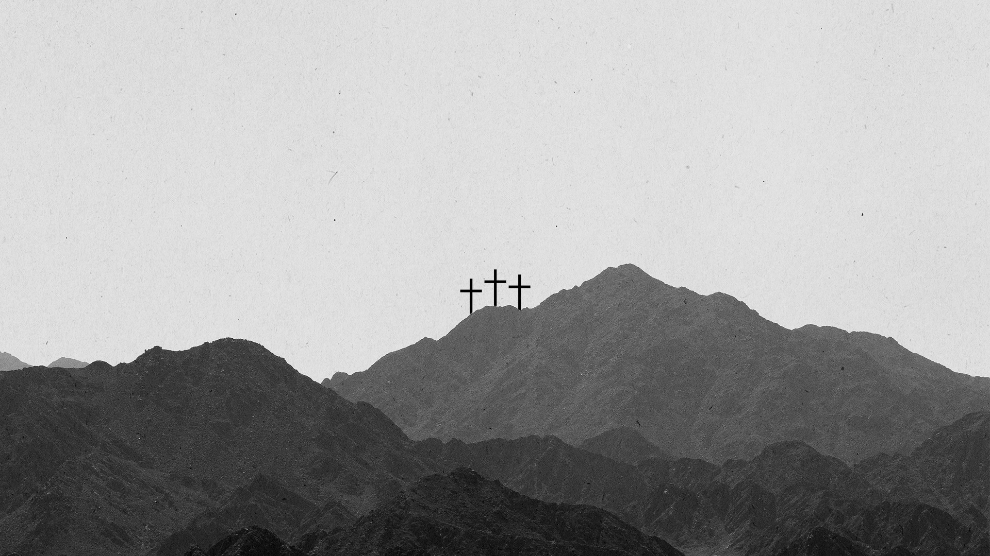
The Seven Greatest Words of Love
A 7-Part Series

Slide 2
The Word of
Trust
Luke 23:44-47

Slide 3
“It was now about noon, and darkness came over the whole land until three in the afternoon, for the sun stopped shining. And the curtain of the temple was torn in two. Jesus called out with a loud voice,

Slide 4
‘Father, into your hands I commit my spirit.’ When he had said this, he breathed his last. The centurion, seeing what had happened, praised God and said, ‘Surely this was a righteous man.’”
Luke 23:44-47

Slide 5
3 Characteristics of Jesus’ Death

Slide 6
3 Characteristics of Jesus’ Death
1. Jesus gave up his life voluntarily.

Slide 7
“No one takes it from me, but I lay it down of my own accord. I have authority to lay it down and authority to take it up again. This command I received from my Father.”
John 10:18 (NIV)

Slide 8
3 Characteristics of Jesus’ Death
1. Jesus gave up his life voluntarily.
2. Jesus gave up his life confidently.

Slide 9
3 Characteristics of Jesus’ Death
1. Jesus gave up his life voluntarily.
2. Jesus gave up his life confidently.
3. Jesus gave up his life trusting God fully.

Slide 10
“Into your hands I commit my spirit; deliver me, Lord, my faithful God.”
Psalm 31:5 (NIV)

Slide 11
He focused on the Father,
not his pain.

Slide 12
3 Truths to Remember in Dark Days

Slide 13
3 Truths to Remember in Dark Days
1. I have a father in heaven who loves me.

Slide 14
“I came from the Father and entered the world; now I am leaving the world and going back to the Father.”
John 16:28 (NIV)

Slide 15
“As a father has compassion on his children, so the Lord has compassion on those who fear him.”
Psalm 103:13 (NIV)

Slide 16
3 Truths to Remember in Dark Days
1. I have a father in heaven who loves me.
2. My father in heaven can be trusted.

Slide 17
“For the word of the Lord is right and true; he is faithful in all he does.”
Psalm 33:4 (NIV)

Slide 18
3 Truths to Remember in Dark Days
1. I have a father in heaven who loves me.
2. My father in heaven can be trusted.
3. My father can handle anything I put in his hands.

Slide 19
How Big are God’s Hands?
1. God’s hands are big enough to bless me.

Slide 20
“You will be a crown of splendor in the Lord’s hand, a royal diadem in the hand of your God.”
Isaiah 62:3 (NIV)

Slide 21
How Big are God’s Hands?
1. God’s hands are big enough to bless me.
2. God’s hands are strong enough to keep me eternally secure.

Slide 22
“I give them eternal life, and they shall never perish; no one will snatch them out of my hand. My Father, who has given them to me, is greater than all; no one can snatch them out of my Father’s hand.”
John 10:28-29 (NIV)

Slide 23
How Big are God’s Hands?
1. God’s hands are big enough to bless me.
2. God’s hands are strong enough to keep me eternally secure.
3. Jesus’ hands are scarred with nail prints so that he cannot forget me.

Slide 24
“Can a mother forget the baby at her breast and have no compassion on the child she has borne? Though she may forget, I will not forget you! See, I have engraved you on the palms of my hands; your walls are ever before me.”
Isaiah 49:15-16 (NIV)

Slide 25
“I think you ought to know, dear brothers, about the hard time we went through in Asia. We were really crushed and overwhelmed, and feared we would never live through it. We felt we were doomed to die and saw how powerless we were to help ourselves;

Slide 26
but that was good, for then we put everything into the hands of God, who alone could save us, for he can even raise the dead.”
2 Corinthians 1:8-9 (TLB)

