Slide 1
The seven greatest words of love
A 7-Part Message Series

Slide 2
“Father, forgive them, for they do not know what they are doing.”
Luke 23:34 (NIV)

Slide 3
The word of assurance
Luke 23:39-43
Part 2

Slide 4
“One of the criminals who hung there hurled insults at him: ‘Aren’t you the Messiah? Save yourself and us!’ But the other criminal rebuked him. ‘Don’t you fear God,’ he said, ‘since you are under the same sentence? We are punished justly, for we are getting what our deeds deserve. But this man has done nothing wrong.’

Slide 5
Then he said, ‘Jesus, remember me when you come into your kingdom.’ Jesus answered him, ‘Truly I tell you, today you will be with me in paradise.’”
Luke 23:39-43 (NIV)

Slide 6
5 Things I Must Know in Order to be Saved

Slide 7
5 Things I Must Know in Order to be Saved
1. I must know I’ll face God after I die.

Slide 8
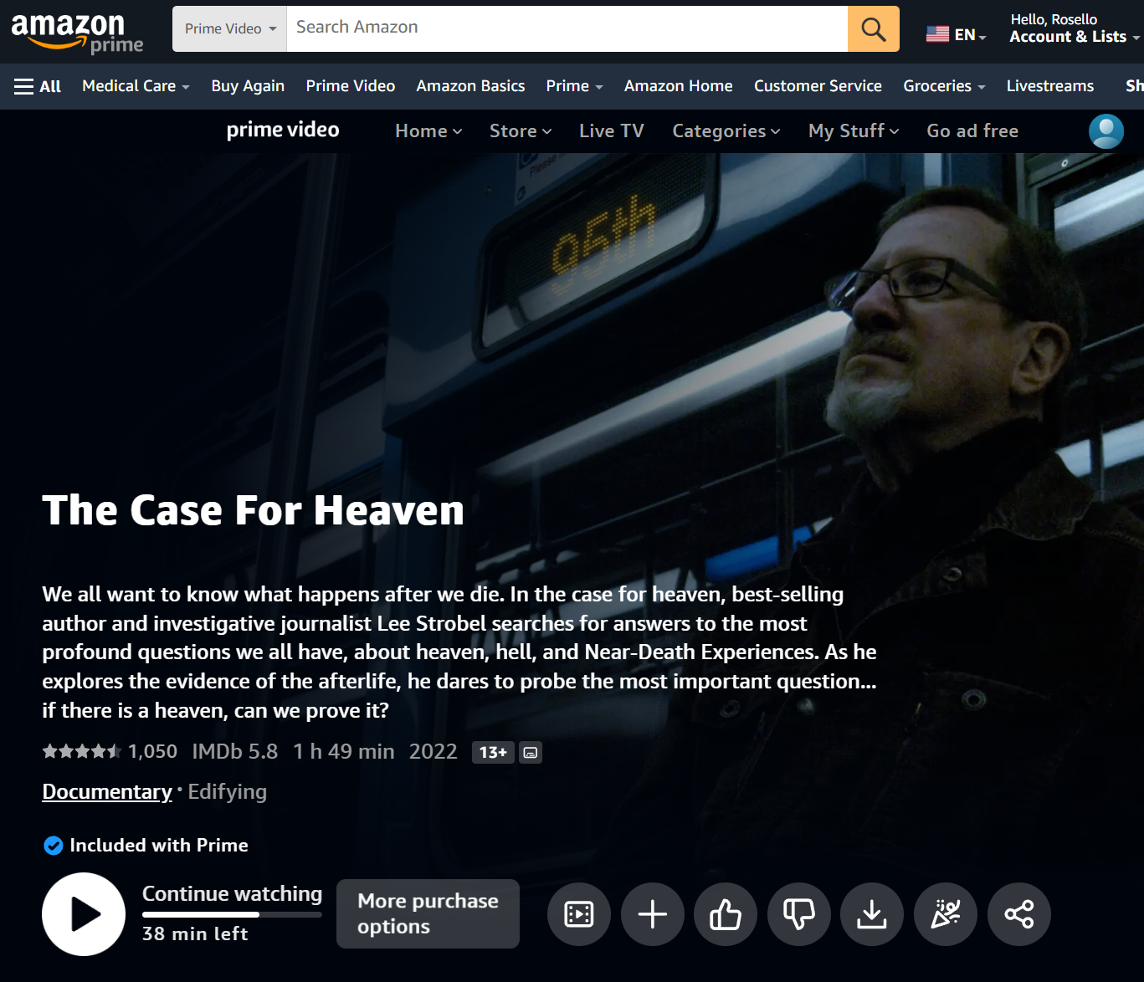

Slide 9
“People are destined to die once, and after that to face judgment.”
Hebrews 9:27 (NIV)

Slide 10
5 Things I Must Know in Order to be Saved
1. I must know I’ll face God after I die.
2. I must know that I’ve sinned against God.

Slide 11
“…we are getting what our deeds deserve…”
Luke 23:41 (NIV)

Slide 12
“If we confess our sins, he is faithful and just and will forgive us our sins and purify us from all unrighteousness.”
1 John 1:9 (NIV)

Slide 13
“The wages of sin is death, but the gift of God is eternal life in Christ Jesus our Lord.”
Romans 6:23 (NIV)

Slide 14
5 Things I Must Know in Order to be Saved
1. I must know I’ll face God after I die.
2. I must know that I’ve sinned against God.
3. I must know that Jesus was more than a man.

Slide 15
“But this man has done nothing wrong.”
Luke 23:41 (NIV)

Slide 16
“Indeed, there is no one on earth who is righteous, no one who does what is right and never sins.”
Ecclesiastes 7:20 (NIV)

Slide 17
“God made him who had no sin to be sin for us, so that in him we might become the righteousness of God.”
2 Corinthians 5:21 (NIV)

Slide 18
“God so loved the world that he gave his only begotten Son that whoever believes in him should not perish but have everlasting life.”
John 3:16 (NIV)

Slide 19
5 Things I Must Know in Order to be Saved
1. I must know I’ll face God after I die.
2. I must know that I’ve sinned against God.
3. I must know that Jesus was more than a man.
4. I must know only God’s grace can save me.

Slide 20
“Then he said, ‘Jesus remember me…’”
Luke 23:42 (NIV)

Slide 21
5 Things I Must Know in Order to be Saved
1. I must know I’ll face God after I die.
2. I must know that I’ve sinned against God.
3. I must know that Jesus was more than a man.
4. I must know only God’s grace can save me.
5. I must know Jesus will save me if I ask.

Slide 22
“Remember me… when you come into your Kingdom.”
Luke 23:42 (NIV)

Slide 23
“Believe in the Lord Jesus, and you will be saved.”
Acts 16:31 (NIV)

Slide 24
4 Facts About Salvation

Slide 25
4 Facts About Salvation
1. It is immediate.
“Truly I tell you, today you will be with me in paradise.”
Luke 23:43 (NIV)

Slide 26
4 Facts About Salvation
1. It is immediate.
2. It is certain
“Truly I tell you, today you will be with me in paradise.”
Luke 23:43 (NIV)

Slide 27
4 Facts About Salvation
1. It is immediate.
2. It is certain
3. It is a relationship
“Truly I tell you, today you will be with me in paradise.”
Luke 23:43 (NIV)

Slide 28
4 Facts About Salvation
1. It is immediate.
2. It is certain
3. It is a relationship
4. It is permanent.
“Truly I tell you, today you will be with me in paradise.”
Luke 23:43 (NIV)

Slide 29
“I tell you, now is the time of God’s favor, now is the day of salvation.”
2 Corinthians 6:2 (NIV)

Slide 30
“Everyone who calls on the name of the Lord will be saved.”
Romans 10:13 (NIV)

