Slide 1
Power to change
A Message Series on the
Book of Romans

Slide 2
The ultimate lifestyle
Romans 8:1-39
Part 20

Slide 3
The Kind of Life that the Holy Spirit Makes Possible to Live

Slide 4
“Therefore, there is now no condemnation for those who are in Christ Jesus.”
Romans 8:1 (NIV)

Slide 5
The Kind of Life that the Holy Spirit Makes Possible to Live
1. We can live a life without condemnation.

Slide 6
“What a wretched man I am! Who will rescue me from this body of death?”
Romans 7:24 (NIV)

Slide 7
“Therefore, there is now no condemnation for those who are in Christ Jesus, because through Christ Jesus the law of the Spirit of life set me free from the law of sin and death. For what the law was powerless to do in that it was weakened by the sinful nature, God did by sending his own Son in the likeness of sinful man to be a sin offering. And so he condemned sin in sinful man...”
Romans 7:24 (NIV)

Slide 8
God is not angry with me anymore.

Slide 9
“For God did not send his Son into the world to condemn the world, but to save the world through him. Whoever believes in him is not condemned, but whoever does not believe stands condemned already because he has not believed in the name of God’s one and only Son.”
John 3:17 (NIV)

Slide 10
“I tell you the truth, whoever hears my word and believes him who sent me has eternal life and will not be condemned; he has crossed over from death to life.”
John 5:24 (NIV)

Slide 11
The Kind of Life that the Holy Spirit Makes Possible to Live
1. We can live a life without condemnation.
2. We can live a life without domination.

Slide 12
“Those who live according to the sinful nature have their minds set on what their nature desires. But those who live according to the Spirit, have their minds set on what the Spirit desires.”
Romans 8:5 (NIV)

Slide 13
“The mind of a sinful man is death, but the mind controlled by the Spirit is life and peace.”
Romans 8:6 (NIV)

Slide 14
“Those controlled by the sinful nature cannot please God.”
Romans 8:8 (NIV)

Slide 15
“You, however, are controlled not by the sinful nature but by the Spirit, if the Spirit of God lives in you. And if anyone does not have the Spirit of Christ, he does not belong to Christ.”
Romans 8:9 (NIV)

Slide 16
“Therefore, brothers, we have an obligation—but it is not to the sinful nature, to live according to it. For if you live according to the sinful nature, you will die; but if by the Spirit you put to death the misdeeds of the body, you will live.”
Romans 8:12-13 (NIV)

Slide 17
The Kind of Life that the Holy Spirit Makes Possible to Live
1. We can live a life without condemnation.
2. We can live a life without domination.
3. We can live a life without desperation.

Slide 18
“I consider that our present sufferings are not worth comparing with the glory that will be revealed in us.”
Romans 8:18 (NIV)

Slide 19
“Therefore we do not lose heart. Though outwardly we are wasting away, yet inwardly we are being renewed day by day. For our light and momentary troubles are achieving for us an eternal glory that far outweighs them all. So we fix our eyes not on what is seen, but on what is unseen. For what is seen is temporary, but what is unseen is eternal.”
2 Corinthians 4:16-18 (NIV)

Slide 20
We can Hope for Two Things
1. We have the hope of a future resurrection.
“Not only so, but we ourselves, who have the firstfruits of the Spirit, groan inwardly as we wait eagerly for our adoption as sons, the redemption of our bodies.”
Romans 8:23 (NIV)

Slide 21
We can Hope for Two Things
2. We have the hope of being prayed for by
the Holy Spirit.
“In the same way, the Spirit helps us in our weakness. We do not know what we ought to pray for, but the Spirit himself intercedes for us with groans that words cannot express.”
Romans 8:26 (NIV)

Slide 22
The Kind of Life that the Holy Spirit Makes Possible to Live
1. We can live a life without condemnation.
2. We can live a life without domination.
3. We can live a life without desperation.
4. We can live a life without miscalculation.

Slide 23
“And we know that in all things God works for the good of those who love him, who have been called according to his purpose.”
Romans 8:28 (NIV)

Slide 24
“For those God foreknew he also predestined to be conformed to the likeness of his Son, that he might be the firstborn among many brothers.”
Romans 8:29 (NIV)

Slide 25
The Kind of Life that the Holy Spirit Makes Possible to Live
1. We can live a life without condemnation.
2. We can live a life without domination.
3. We can live a life without desperation.
4. We can live a life without miscalculation.
5. We can live a life without intimidation.

Slide 26
“What then shall we say in response to this? If God is for us who can be against us?”
Romans 8:31 (NIV)

Slide 27
“Who will bring any charge against those whom God has chosen? It is God who justifies. Who is he that condemns? Christ Jesus, who died—more than that, who was raised to life—is at the right hand of God and is also interceding for us?”
Romans 8:33 (NIV)

Slide 28
“So we say with confidence, ‘The Lord is my helper. I will not be afraid. What can man do to me?’”
Hebrews 13:6 (NIV)

Slide 29
“The fear of man is a snare.”
Proverbs 29:25 (NIV)

Slide 30
“In all of these things we are more than conquerors through him who loved us.”
Romans 8:37a (NIV)

Slide 31
The Kind of Life that the Holy Spirit Makes Possible to Live
1. We can live a life without condemnation.
2. We can live a life without domination.
3. We can live a life without desperation.
4. We can live a life without miscalculation.
5. We can live a life without intimidation.
6. We can live a life without limitation.

Slide 32
“He who did not spare his own Son, but gave him up for us all—how will he not also, along with him, graciously give us all things?”
Romans 8:32 (NIV)

Slide 33
The Kind of Life that the Holy Spirit Makes Possible to Live
1. We can live a life without condemnation.
2. We can live a life without domination.
3. We can live a life without desperation.
4. We can live a life without miscalculation.
5. We can live a life without intimidation.
6. We can live a life without limitation.
7. We can live a life without separation.

Slide 34
“Who shall separate us from the love of Christ? Shall trouble or hardship or persecution or famine or nakedness or danger or sword? As it is written: ‘For your sake we face death all day long; we are considered as sheep to be slaughtered.’ No, in all these things we are more than conquerors through him who loved us…

Slide 35
“For I am convinced that neither death nor life, neither angels nor demons, neither the present nor the future, nor any powers, neither height nor depth, nor anything else in all creation, will be able to separate us from the love of God that is in Christ Jesus our Lord.”
Romans 8:35-39 (NIV)

Slide 36
“I give them eternal life, and they shall never perish; no one can snatch them out of my hand.”
John 10:28 (NIV)

Slide 37
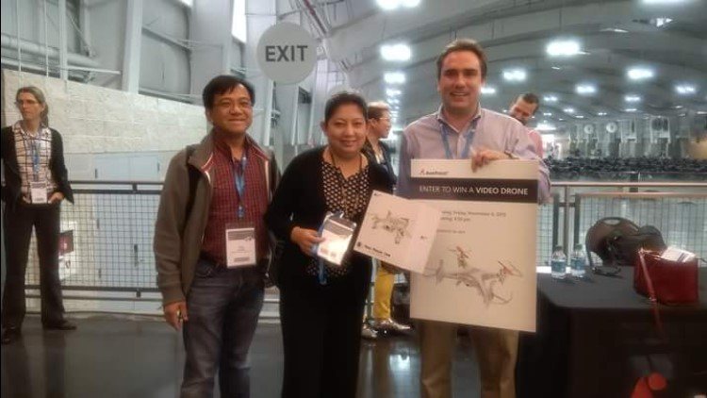

Slide 38
“Do not fear, for I have redeemed you; I have summoned you by name; you are mine. When you pass through the waters, I will be with you; and when you pass through the rivers, they will not sweep over you. When you walk through the fire, you will not be burned; the flames will not set you ablaze. For I am the Lord your God, the Holy One of Israel, your Savior.”
Isaiah 43:1b-3a (NIV)

