Slide 1
HOW TO WORK AND BE HAPPY
Selected Verses

Slide 2
“.”
2 Thessalonians 3:11-12 (NIV)

Slide 3
“Make it your ambition to lead a quiet life, to mind your own business and to work with your hands, just as we told you, so that your daily life may win the respect of outsiders and so that you will not be dependent on anybody.”
1 Thessalonians 4:11-12 (NIV)

Slide 4
“For even when we were with you, we gave you this rule: ‘If a man will not work, he shall not eat.’ We hear that some among you are idle and disruptive. They are not busy; they are busybodies. Such people we command and urge in the Lord Jesus Christ to settle down and earn the food they eat.”
2 Thessalonians 3:10-12 (NIV)

Slide 5
…And as for you, brothers, never tire of doing what is right.”

Slide 6
“He who has been stealing must steal no longer but must work, doing something useful with his hands.”
Ephesians 5:28 (NIV)

Slide 7
You can be happy
at work if you…

Slide 8
View it as a blessing.

Slide 9
“The greatest analgesic, soporific, stimulant, tranquilizer, narcotic, and to some extent even antibiotic—in short, the closest thing to a genuine panacea—known to medical science is work.”
Dr. Thomas Szasz,
American academic and psychiatrist

Slide 10
“The man who does what he loves will never work another day in his life.”
Ronald Reagan,
Former US President

Slide 11
2. View it as a bridge.

Slide 12
a. It as a bridge for building a great reputation

Slide 13
“Every job is a self-portrait of the person who does it. Autograph your work with excellence.”
- Anonymous

Slide 14
b. It as a bridge for ministering to the needs of others

Slide 15
“Therefore, as we have opportunity, let us do good to all people.”
Galatians 6:10 (NIV)

Slide 16
“Each of you should look not only to your own interests, but also to the interests of others.”
Philippians 2:4 (NIV)

Slide 17
“People never care how much you know until they know how much you care”.
- Anonymous

Slide 18
c. It as a bridge for introducing the reality of Jesus Christ

Slide 19
“Be wise in the way you act toward outsiders; make the most of every opportunity. Let your conversation be always full of grace, seasoned with salt, so that you may know how to answer everyone.”
Colossians 4:5-6 (NIV)

Slide 20
“But in your hearts set apart Christ as Lord. Always be prepared to give an answer to everyone who asks you to give the reason for the hope that you have…

Slide 21
…But do this with gentleness and respect, keeping a clear conscience, so that those who speak maliciously against your good behavior in Christ may be ashamed of their slander.”
1 Peter 3:15-16 (NIV)

Slide 22
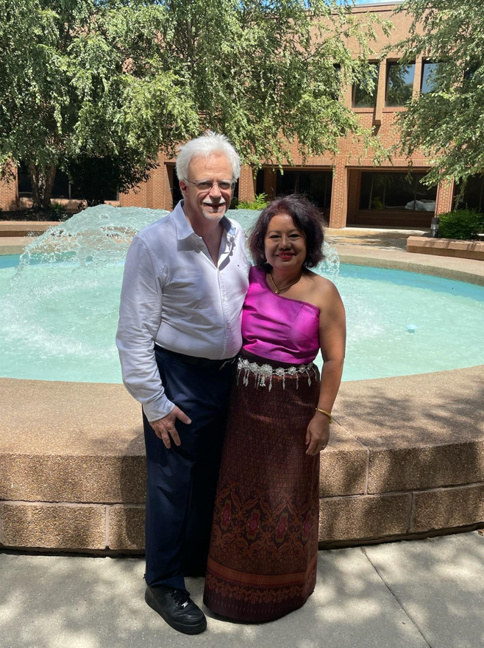

Slide 23
3. View it as a building project.

Slide 24
“Whatever you do, work at it with all your heart, as working for the Lord, not for men, since you know that you will receive an inheritance from the Lord as a reward. It is the Lord Christ you are serving.”
Colossians 3:23-24 (NIV)

Slide 25
“And whatever you do, whether in word or deed, do it all in the name of the Lord Jesus, giving thanks to God the Father through him.”
Colossians 3:17 (NIV)

Slide 26
“For we are God’s fellow workers; you are God’s field, God’s building. By the grace God has given me, I laid a foundation as an expert builder, and someone else is building on it. But each one should be careful how he builds. For no one can lay any foundation other than the one already laid, which is Jesus Christ…

Slide 27
…If any man builds on this foundation using gold, silver, costly stones, wood, hay or straw, his work will be shown for what it is, because the Day will bring it to light. It will be revealed with fire, and the fire will test the quality of each man’s work…

Slide 28
...If what he has built survives, he will receive his reward. If it is burned up, he will suffer loss; he himself will be saved, but only as one escaping through the flames.”
1 Corinthians 3:9-15 (NIV)

Slide 30
“Then I realized that it is good and proper for a man to eat and drink, and to find satisfaction in his toilsome labor under the sun during the few days of life God has given him.”
Ecclesiastes 5:18-19 (NIV)

