Slide 1
THE BEST WAY TO LIVE YOUR LIFE
1 Cor. 12:31b; 13:1-3

Slide 2
“But now let me show you a way of life that is best of all. If I could speak all the languages of earth and of angels, but didn’t love others, I would only be a noisy gong or a clanging cymbal. If I had the gift of prophecy, and if I understood all of God’s secret plans and possessed all knowledge, and if I had such faith that I could move mountains,

Slide 3
I would be nothing. If I gave everything I have to the poor and even sacrificed my body, I could boast about it; but if I didn’t love others,
I would have gained nothing.”
1 Cor. 12:31b; 13:1-3 (NLT)

Slide 4
"If it is possible, as far as it depends on you, live at peace with everyone"
Romans 12:18 (NIV)

Slide 5
"Be completely humble and gentle; be patient, bearing with one another in love"
Ephesians 4:2 (NIV)

Slide 6
"Make every effort to live in peace with all men and to be holy..."
Hebrews 12:14 (NIV)

Slide 7
1. The Importance of Love in Our Lives

Slide 8
“But now let me show you a way of life that is best of all.” (v. 31b)

Slide 9
“If I could speak all the languages of earth and of angels, but didn’t love others, I would only be a noisy gong or a clanging cymbal.”
(v. 1)

Slide 10
“If I had the gift of prophecy,
and if I understood all of God’s secret plans and possessed all knowledge... but didn’t love others, I would be nothing.”
(v. 2)

Slide 11
“Knowledge puffs you up with pride, but love builds up.”
1 Corinthians 8:1 (NCV)

Slide 12
“If I had such faith that I could move mountains, but didn’t love others, I would be nothing.”
(v. 2)

Slide 13
"The only thing that counts is faith expressing itself through love."
Gal. 5:6 (NIV)

Slide 14
“If I gave everything I have to the poor …but if I didn’t love others, I would have gained nothing.”
(v. 3)

Slide 15
“If I …even sacrificed my body… but if I didn’t love others, I would have gained nothing.”
(v. 3)

Slide 16
2. The Practice of Love in Our Everyday Lives

Slide 17
"A new commandment I give you: Love one another.
As I have loved you, so you must love one another."
John 13:34 (NIV)

Slide 18
"Each of you should look not only to your own interests, but also to the interests of others."
Philippians 2:4 (NIV)

Slide 19
"By this everyone will know that you are my disciples, if you love one another."
John 13:35 (NIV)

Slide 20
"If your enemy is hungry, feed him; if he is thirsty, give him something to drink...Do not be overcome by evil, but overcome evil with good."
Romans 12:20-21 (NIV)

Slide 21
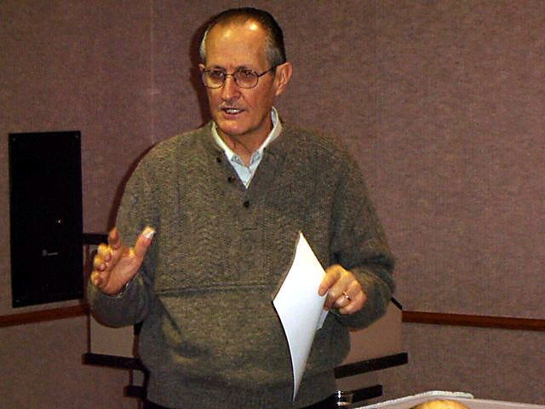
Doug Nichols

